Slide 1
UPPER SIXTH ARTS
GEOGRAPHY
Quantitative Techniques 3 (Part 3)
Measures of Association: Spearman's Rank Correlation
Notes:
Good morning, class, and welcome to our geography lesson. I am your geography teacher, Mr Kamdem. Today we are starting Quantitative Techniques 3 (Part 3): Measures of Association: Spearman's Rank Correlation.

Slide 2
CLASS INFO
Class, Chapter and Duration
Class | Upper Sixth Arts
Chapter | Module 8: Understanding and carrying out statistical techniques, topographic map analysis, fieldwork and project based learning
Duration | 2 periods (2 × 50 minutes)
Notes:
This lesson is for Upper Sixth Arts. It belongs to Module 8: Understanding and carrying out statistical techniques, topographic map analysis, fieldwork and project based learning. We shall need 2 periods to cover it.

Slide 3
IDENTIFICATION
Lesson Identification
Topic | Quantitative Techniques in Geography
Sub-topic | Statistical Techniques
Lesson | Quantitative Techniques 3 (Part 3): Measures of Association: Spearman's Rank Correlation
Notions / Concepts | Association, correlation, positive and negative correlation, rank, tied ranks, Spearman's rank correlation coefficient (Rs), null hypothesis, significance.
Syllabus focus | Meaning and uses of Spearman's rank correlation; the formula and steps of calculation; interpretation and significance; worked example (slope angle and soil depth).
Competence | Learners are able to calculate, interpret and test the significance of Spearman's rank correlation for geographical data.
Notes:
Our topic is Quantitative Techniques in Geography, and the sub-topic is Statistical Techniques. The key notions we shall use today are: association, correlation, positive and negative correlation, rank, tied ranks, Spearman's rank correlation coefficient (Rs), null hypothesis, significance. At the end, you should be able to do this: learners are able to calculate, interpret and test the significance of Spearman's rank correlation for geographical data.

Slide 4

HOMEWORK CORRECTION
Correction of the Homework
Question (Quantitative Techniques 3 (Part 2): Measures of Dispersion: Variance, Standard Deviation and Coefficient of Variation):
Rank these values from highest to lowest: 12, 30, 25, 18.
Notes:
Before we start the new lesson, let us correct the homework I gave you at the end of Quantitative Techniques 3 (Part 2): Measures of Dispersion: Variance, Standard Deviation and Coefficient of Variation. The question was: Rank these values from highest to lowest: 12, 30, 25, 18. Take out your exercise books.

Slide 5
HOMEWORK CORRECTION
Correction: Possible Answer
30 (rank 1), 25 (rank 2), 18 (rank 3), 12 (rank 4).
Notes:
Here is a good answer. 30 (rank 1), 25 (rank 2), 18 (rank 3), 12 (rank 4). Compare it with your own answer and correct your work in red.

Slide 6
LESSON PLAN
Lesson Plan
Correction of the homework
Objectives and recall
Real-life situation and action to take
Learning activities
Board summary
Evaluation, remediation and homework
Notes:
Here is the plan of our lesson today. First, we shall correct the homework. Then we shall look at the objectives and recall what you already know. After that, we shall study a situation from real life and the action to take, and do the learning activities. Finally, we shall copy the board summary, do the evaluation and the remediation, and I will give you the homework.

Slide 7
OBJECTIVES
Objectives
By the end of this lesson, you should be able to:
Explain what Spearman's rank correlation measures.
Rank data, including tied values.
Calculate Rs step by step.
Notes:
Take your time to copy this part; we will continue together.

Slide 8
OBJECTIVES
Objectives (continued)
Interpret the strength and direction of Rs.
Test the significance of Rs.
Notes:
By the end of this lesson, you should be able to do five things. Number 1: explain what Spearman's rank correlation measures. Number 2: rank data, including tied values. Number 3: calculate Rs step by step. Number 4: interpret the strength and direction of Rs. Number 5: test the significance of Rs.

Slide 9
PREVIOUS KNOWLEDGE
Previous Knowledge
Data can be ranked from highest to lowest.
A scatter graph shows a relationship between two variables.
Soil is thin on steep slopes.
Notes:
Let us first remember what you already know. Data can be ranked from highest to lowest. A scatter graph shows a relationship between two variables. Soil is thin on steep slopes. Keep this in mind, because we shall build on it today.

Slide 10
REAL-LIFE SITUATION
Situation in Real Life
During fieldwork on a hill near Garoua, students measured the slope angle and the soil depth at 10 points.
They expected thin soils on steep slopes, but the figures seem to show the opposite.
Their teacher tells them: "Do not guess.
Notes:
Take your time to copy this part; we will continue together.

Slide 11
REAL-LIFE SITUATION
Situation in Real Life (continued)
Measure the relationship."
A student asks: "How can we calculate whether slope angle and soil depth are really related, and how strongly?"
Notes:
Listen carefully to this situation from real life. During fieldwork on a hill near Garoua, students measured the slope angle and the soil depth at 10 points. They expected thin soils on steep slopes, but the figures seem to show the opposite. Their teacher tells them: "Do not guess. Measure the relationship." A student asks: "How can we calculate whether slope angle and soil depth are really related, and how strongly?" Think about it, because I am going to ask you some questions.

Slide 12
REAL-LIFE SITUATION
Situation: Question 1
What is the problem in the situation?
Notes:
Question 1: What is the problem in the situation? Think for a moment, then raise your hand to answer.

Slide 13
REAL-LIFE SITUATION
Answer
The students do not know how to measure the relationship between two variables.
Notes:
Good. The students do not know how to measure the relationship between two variables.

Slide 14
REAL-LIFE SITUATION
Situation: Question 2
Which statistic measures the relationship with ranks?
Notes:
Question 2: Which statistic measures the relationship with ranks? Think for a moment, then raise your hand to answer.

Slide 15
REAL-LIFE SITUATION
Answer
Spearman's rank correlation coefficient (Rs).
Notes:
Good. Spearman's rank correlation coefficient (Rs).

Slide 16
REAL-LIFE SITUATION
Situation: Question 3
What will the null hypothesis say?
Notes:
Question 3: What will the null hypothesis say? Think for a moment, then raise your hand to answer.

Slide 17
REAL-LIFE SITUATION
Possible Answer
There is no relationship between slope angle and soil depth.
Notes:
Good. There is no relationship between slope angle and soil depth.

Slide 18
ACTION TO TAKE
Action to Take
Always state a null hypothesis, calculate Rs and test its significance before concluding.
Notes:
From this situation, the action we are working towards in this lesson is the following: always state a null hypothesis, calculate Rs and test its significance before concluding.

Slide 19
JUSTIFICATION
Justification of the Lesson
This lesson gives a key tool to test geographical relationships in fieldwork and examinations.
Notes:
Why is this lesson important for you? This lesson gives a key tool to test geographical relationships in fieldwork and examinations.

Slide 20
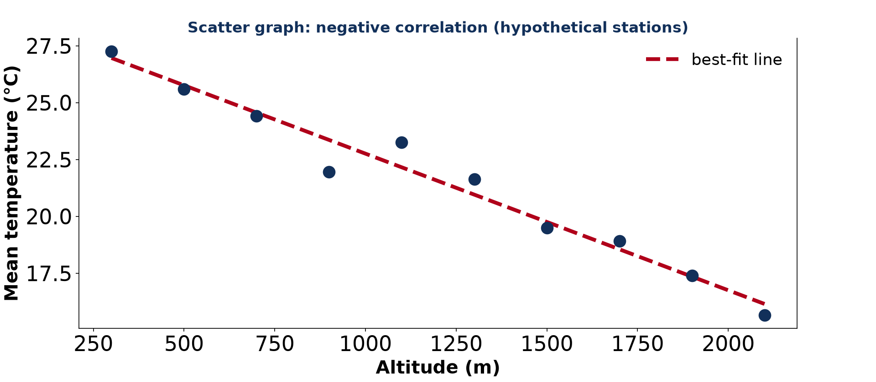
1. MEANING
Activity 1
A negative correlation.
Notes:
Activity 1. Look carefully at this diagram: a negative correlation. Observe every detail before I ask the question.

Slide 21
1. MEANING
Activity 1: Question
What kind of correlation does this graph show?
Notes:
Here is the question for Activity 1: What kind of correlation does this graph show? Take one minute to think and write your answer in your rough notebook.

Slide 22
1. MEANING
Activity 1: Answer
A negative correlation: one variable increases as the other decreases.
Notes:
Let us check the answer together. A negative correlation: one variable increases as the other decreases.

Slide 23
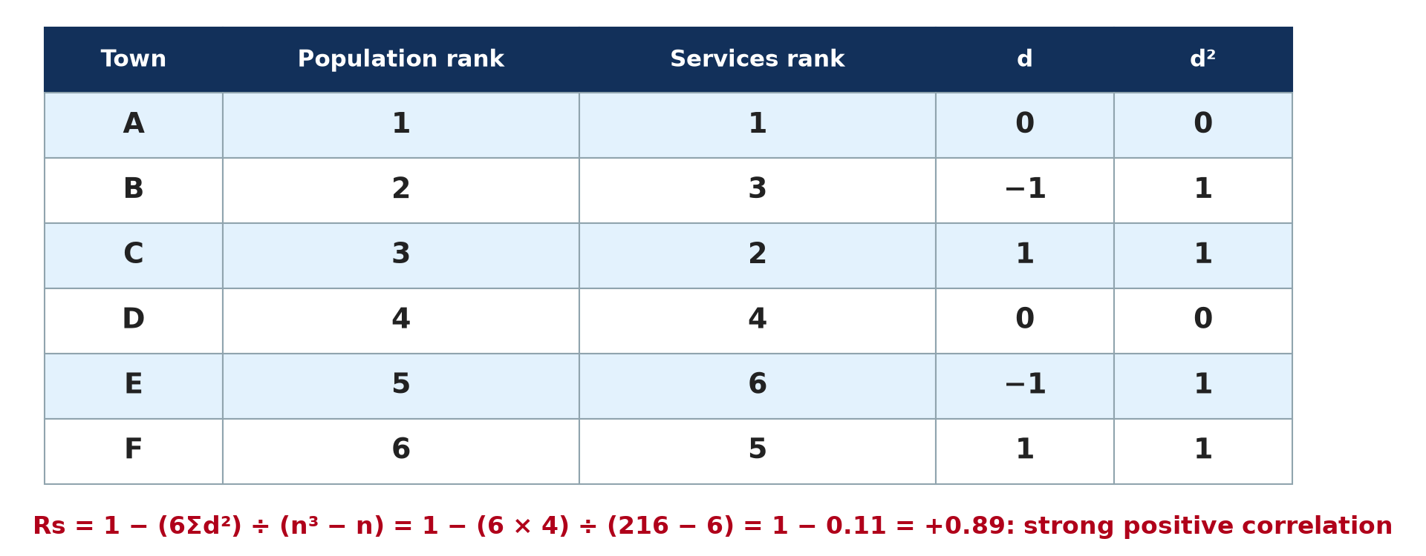
2. RANKING
Activity 2
A simple Spearman table.
Notes:
Activity 2. Look carefully at this diagram: a simple Spearman table. Observe every detail before I ask the question.

Slide 24
2. RANKING
Activity 2: Question
Two equal values would occupy ranks 2 and 3. Which rank do they receive?
Notes:
Here is the question for Activity 2: Two equal values would occupy ranks 2 and 3. Which rank do they receive? Take one minute to think and write your answer in your rough notebook.

Slide 25
2. RANKING
Activity 2: Answer
(2 + 3) ÷ 2 = 2.5 each.
Notes:
Let us check the answer together. (2 + 3) ÷ 2 = 2.5 each.

Slide 26
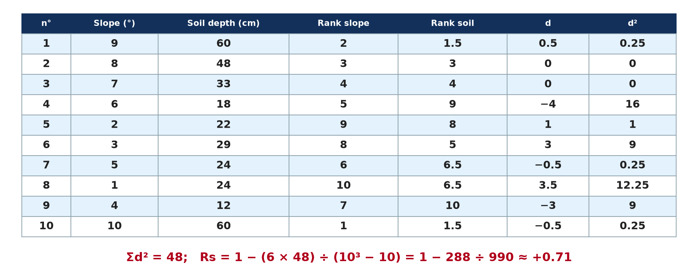
3. CALCULATION
Activity 3
Slope angle and soil depth.
Notes:
Activity 3. Look carefully at this picture: slope angle and soil depth. Observe every detail before I ask the question.

Slide 27
3. CALCULATION
Activity 3: Question
Calculate Rs if Σd² = 48 and n = 10.
Notes:
Here is the question for Activity 3: Calculate Rs if Σd² = 48 and n = 10. Take one minute to think and write your answer in your rough notebook.

Slide 28
3. CALCULATION
Activity 3: Answer
Rs = 1 − 288 ÷ 990 ≈ +0.71.
Notes:
Let us check the answer together. Rs = 1 − 288 ÷ 990 ≈ +0.71.

Slide 29
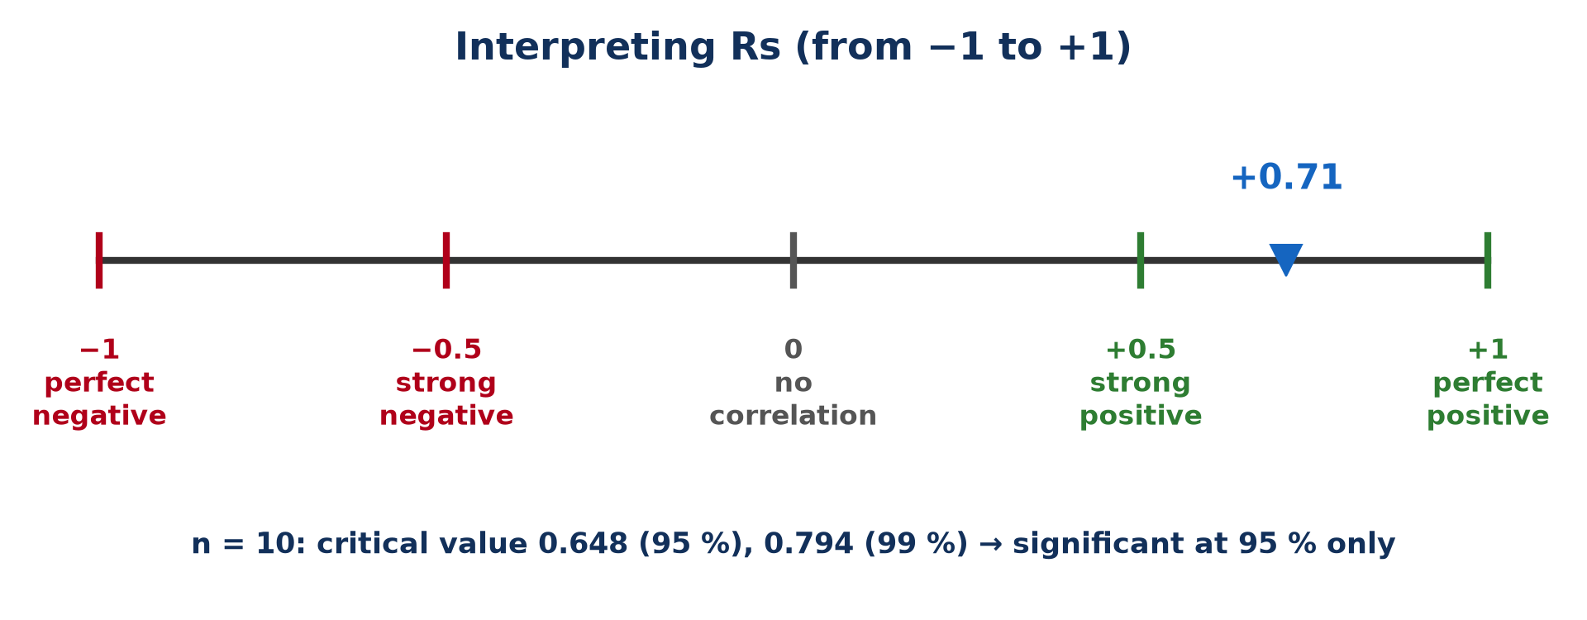
4. INTERPRETATION
Activity 4
Interpreting Rs.
Notes:
Activity 4. Look carefully at this picture: interpreting Rs. Observe every detail before I ask the question.

Slide 30
4. INTERPRETATION
Activity 4: Question
What does Rs = +0.71 mean?
Notes:
Here is the question for Activity 4: What does Rs = +0.71 mean? Take one minute to think and write your answer in your rough notebook.

Slide 31
4. INTERPRETATION
Activity 4: Answer
A fairly strong positive correlation.
Notes:
Let us check the answer together. A fairly strong positive correlation.

Slide 32

4. SIGNIFICANCE
Activity 5
Measuring soil depth.
Notes:
Activity 5. Look carefully at this picture: measuring soil depth. Observe every detail before I ask the question.

Slide 33
4. SIGNIFICANCE
Activity 5: Question
Is Rs = 0.71 significant at 95 % for n = 10 (critical value 0.648)?
Notes:
Here is the question for Activity 5: Is Rs = 0.71 significant at 95 % for n = 10 (critical value 0.648)? Take one minute to think and write your answer in your rough notebook.

Slide 34
4. SIGNIFICANCE
Activity 5: Answer
Yes: 0.71 is greater than 0.648, so the null hypothesis is rejected.
Notes:
Let us check the answer together. Yes: 0.71 is greater than 0.648, so the null hypothesis is rejected.

Slide 35
BOARD SUMMARY
Board Summary
Topic: Quantitative Techniques in Geography
Sub-topic: Statistical Techniques
Quantitative Techniques 3 (Part 3): Measures of Association: Spearman's Rank Correlation
Notes:
Now we are going to copy the board summary. Write the title and the headings neatly in your notebooks. I will give you enough time for each slide, so do not rush.

Slide 36
BOARD SUMMARY
DEFINITIONS
The key terms of this lesson are defined as follows:
Correlation: It is the relationship between two variables.
Notes:
Let us copy the definitions. The key terms of this lesson are defined as follows. On this slide we have Correlation. Write each point on a new line, with the key term first, and explain it in your own words when we revise. When you finish, we go to the next slide.

Slide 37
BOARD SUMMARY
DEFINITIONS (continued)
Spearman's rank correlation coefficient (Rs): It is a measure of the strength and direction of the relationship between two variables using their ranks.
Null hypothesis (H0): It is the statement that there is no relationship between the two variables.
Notes:
We continue with the definitions. On this slide we have Spearman's rank correlation coefficient (Rs) and Null hypothesis (H0). Write each point on a new line, with the key term first, and explain it in your own words when we revise. When you finish, we go to the next slide.

Slide 38
BOARD SUMMARY
DEFINITIONS (continued)
Significance: It is the level of confidence that a correlation is real and not due to chance.
Notes:
We continue with the definitions. On this slide we have Significance. Write each point on a new line, with the key term first, and explain it in your own words when we revise.

Slide 39
BOARD SUMMARY
1. Meaning and Uses of Spearman's Rank Correlation
Spearman's rank correlation shows the following:
Existence and strength: Rs shows whether a relationship exists between two variables; Rs = 0 means there is none. The closer Rs is to +1 or −1, the stronger the relationship.
Illustration: types of correlation
Notes:
Let us copy Meaning and Uses of Spearman's Rank Correlation. Spearman's rank correlation shows the following. Copy the point on Existence and strength on the left, then draw the diagram on the right: types of correlation. Give it a title and label it clearly.

Slide 40
BOARD SUMMARY
1. Meaning and Uses of Spearman's Rank Correlation
Direction: A positive correlation means that both variables rise or fall together, like altitude and rainfall on a windward slope. A negative correlation means that one rises while the other falls, like altitude and temperature.
Notes:
We continue with Meaning and Uses of Spearman's Rank Correlation. Copy the point on Direction: write the key term first, then its explanation.

Slide 41
BOARD SUMMARY
1. Meaning and Uses of Spearman's Rank Correlation
Use of ranks: The method uses the ranks of the values instead of the values themselves. It therefore works with ordinal data and with very uneven values.
Notes:
We continue with Meaning and Uses of Spearman's Rank Correlation. Copy the point on Use of ranks: write the key term first, then its explanation.

Slide 42
BOARD SUMMARY
2. Formula and Steps of Calculation
A) The Formula
The formula of Spearman is used as follows:
Formula: Rs = 1 − (6Σd²) ÷ (n³ − n), where d is the difference between the two ranks of each pair and n is the number of pairs. The result always lies between −1 and +1.
Illustration: Spearman's formula
Notes:
Let us copy The Formula. The formula of Spearman is used as follows. Copy the point on Formula on the left, then draw the diagram on the right: spearman's formula. Give it a title and label it clearly.

Slide 43
BOARD SUMMARY
2. Formula and Steps of Calculation
A) The Formula
Tied ranks: When two values are equal, they share the average of the ranks they occupy. For example, two soil depths of 60 cm occupying ranks 1 and 2 each get rank 1.5.
Notes:
We continue with The Formula. Copy the point on Tied ranks: write the key term first, then its explanation.

Slide 44
BOARD SUMMARY
2. Formula and Steps of Calculation
B) The Steps
Rs is calculated in the following steps:
Step 1, the hypothesis: State the null hypothesis (H0), which says that there is no relationship between the two variables. Then count the number of pairs (n).
Notes:
Let us copy The Steps. Rs is calculated in the following steps. Copy the point on Step 1, the hypothesis: write the key term first, then its explanation.

Slide 45
BOARD SUMMARY
2. Formula and Steps of Calculation
B) The Steps
Step 2, the ranks: Rank each variable separately, giving rank 1 to the highest value. Write the two ranks of each pair side by side in a table.
Notes:
We continue with The Steps. Copy the point on Step 2, the ranks: write the key term first, then its explanation.

Slide 46
BOARD SUMMARY
2. Formula and Steps of Calculation
B) The Steps
Step 3, the differences: For each pair, calculate the difference d between the two ranks and square it. Add all the squares to find Σd².
Notes:
We continue with The Steps. Copy the point on Step 3, the differences: write the key term first, then its explanation.

Slide 47
BOARD SUMMARY
2. Formula and Steps of Calculation
B) The Steps
Step 4, the result: Substitute Σd² and n into the formula to find Rs. Then interpret its sign and its value.
Notes:
We continue with The Steps. Copy the point on Step 4, the result: write the key term first, then its explanation.

Slide 48
BOARD SUMMARY
3. Worked Example: Slope Angle and Soil Depth
The worked example is solved as follows:
Hypothesis and data: H0: there is no significant relationship between slope angle and soil depth. Slope angle and soil depth are measured at 10 points on a hill, and each variable is ranked.
Illustration: the calculation table
Notes:
Let us copy Worked Example: Slope Angle and Soil Depth. The worked example is solved as follows. Copy the point on Hypothesis and data on the left, then draw the diagram on the right: the calculation table. Give it a title and label it clearly.

Slide 49
BOARD SUMMARY
3. Worked Example: Slope Angle and Soil Depth
Calculation: The table gives Σd² = 48 and n = 10. Rs = 1 − (6 × 48) ÷ (1,000 − 10) = 1 − 288 ÷ 990 ≈ +0.71.
Notes:
We continue with Worked Example: Slope Angle and Soil Depth. Copy the point on Calculation: write the key term first, then its explanation.

Slide 50
BOARD SUMMARY
3. Worked Example: Slope Angle and Soil Depth
Interpretation: Rs = +0.71 shows a fairly strong positive correlation: on this hill, soils tend to be deeper where slopes are steeper. This may be explained by vegetation or rock type.
Notes:
We continue with Worked Example: Slope Angle and Soil Depth. Copy the point on Interpretation: write the key term first, then its explanation.

Slide 51
BOARD SUMMARY
4. Interpretation and Significance
Rs is interpreted and tested as follows:
Positive values: Rs = +1 is a perfect positive correlation, +0.5 to +0.9 a strong one and +0.1 to +0.4 a weak one. Rs = 0 means there is no correlation.
Illustration: the scale of Rs
Notes:
Let us copy Interpretation and Significance. Rs is interpreted and tested as follows. Copy the point on Positive values on the left, then draw the diagram on the right: the scale of Rs. Give it a title and label it clearly.

Slide 52
BOARD SUMMARY
4. Interpretation and Significance
Negative values: Rs = −1 is a perfect negative correlation, −0.5 to −0.9 a strong one and −0.1 to −0.4 a weak one. The sign shows the direction and the value shows the strength.
Notes:
We continue with Interpretation and Significance. Copy the point on Negative values: write the key term first, then its explanation.

Slide 53
BOARD SUMMARY
4. Interpretation and Significance
Significance test: Rs is compared with the critical values given in tables for the same number of pairs. If Rs is greater than the critical value, the correlation is significant.
Notes:
We continue with Interpretation and Significance. Copy the point on Significance test: write the key term first, then its explanation.

Slide 54
BOARD SUMMARY
4. Interpretation and Significance
Application and conclusion: For n = 10, the critical values are 0.648 at 95 % and 0.794 at 99 %, so Rs = 0.71 is significant at 95 % but not at 99 %. We therefore reject H0 at the 95 % level: the relationship is real and not due to chance.
Notes:
We continue with Interpretation and Significance. Copy the point on Application and conclusion: write the key term first, then its explanation.

Slide 55
FORMATIVE EVALUATION
Evaluation 1
State a null hypothesis for rainfall and crop yield.
Notes:
Now let us check what you have understood. Question 1: State a null hypothesis for rainfall and crop yield. Answer in your exercise book.

Slide 56
FORMATIVE EVALUATION
Expected Answer
H0: there is no significant relationship between annual rainfall and crop yield.
Notes:
The expected answer is: h0: there is no significant relationship between annual rainfall and crop yield. If you got it right, well done.

Slide 57
FORMATIVE EVALUATION
Evaluation 2
Six pairs give Σd² = 4. Calculate Rs and interpret it.
Notes:
Now let us check what you have understood. Question 2: Six pairs give Σd² = 4. Calculate Rs and interpret it. Answer in your exercise book.

Slide 58
FORMATIVE EVALUATION
Expected Answer
Rs = 1 − 24 ÷ 210 ≈ +0.89: a strong positive correlation.
Notes:
The expected answer is: rs = 1 − 24 ÷ 210 ≈ +0.89: a strong positive correlation. If you got it right, well done.

Slide 59
REMEDIATION
Remediation
Fill in the blanks:
Rs always lies between −1 and ______.
The null hypothesis says there is ______ relationship.
Rs = 1 − (6Σd²) ÷ (n³ − ______).
Notes:
For those who need more practice, fill in the blanks in your exercise book. The answers are: number 1, +1; number 2, no; number 3, n.

Slide 60
HOMEWORK
Homework
Name three types of graphs.
Notes:
For your homework: Name three types of graphs. We shall correct it at the beginning of our next lesson.

Slide 61
NEXT LESSON
Next Lesson
Our next lesson will be on:
Quantitative Techniques 4: Plotting and Interpreting Graphical Tools
Notes:
Our next lesson will be on Quantitative Techniques 4: Plotting and Interpreting Graphical Tools. Thank you for your attention, and see you next time.

Slide 62
BILINGUAL GAME
Bilingual Game (Jeu Bilingue)
English | Français
Correlation | La corrélation
Rank | Le rang
Null hypothesis | L'hypothèse nulle
Significance | La significativité
Positive | Positif
Negative | Négatif
Notes:
Let us play the bilingual game. I say a word in English, and you give me the French word. Then we do the reverse.

Slide 63
LOGBOOK
Official Logbook (1/2)
Module / Topic | Quantitative Techniques in Geography
Lesson Title | Quantitative Techniques 3 (Part 3): Measures of Association: Spearman's Rank Correlation
Expected Learning Outcomes | Explain what Spearman's rank correlation measures. Rank data, including tied values. Calculate Rs step by step. Interpret the strength and direction of Rs. Test the significance of Rs.
Competence | Learners are able to calculate, interpret and test the significance of Spearman's rank correlation for geographical data.
Notes:
I record this information in the official logbook of the class after the lesson.

Slide 64
LOGBOOK
Official Logbook (2/2)
Matter Taught | DEFINITIONS; Meaning and Uses of Spearman's Rank Correlation; The Formula; The Steps; Worked Example: Slope Angle and Soil Depth; Interpretation and Significance.
Evaluation | Formative evaluation and remediation exercise.
Homework | Name three types of graphs.
Enrolment / Present / Absent | ____ / ____ / ____
Achievement | To be completed after the lesson.
Notes:
I complete the second page of the logbook: the matter taught, the evaluation, the homework and the attendance.

Slide 65
TEACHER'S NOTE
Teacher's Note
Timing: Homework correction, plan, objectives 8 min | Recall, situation, action 10 min | 5 activities 30 min | Board summary (copying) 30 min | Evaluation, remediation 10 min | Homework, next lesson 5 min | Logbook 7 min
Without the projector (Activity 1): draw positive and negative patterns.
Without the projector (Activity 2): rank the heights of five students.
Without the projector (Activity 3): complete the table on the board.
Without the projector (Activity 4): draw the scale from −1 to +1.
Without the projector (Activity 5): compare with the critical value.
Notes:
This slide is for me, the teacher: it gives the timing of the lesson and what to do if the projector is not available.

Slide 66
REFERENCES
References
Geography Syllabus for Sixth Forms (Lower and Upper Sixth), MINESEC, 2019 — Module 8 (Practical Geography).
Teacher's course notes: Mr KAMDEM E., Statistical Techniques in Geographical Analysis (USA), GBHS Garoua, 2026.
Photo, Activity 5: “Humic Dystrudept (fine-loamy, isotic, frigid)” by SoilScience.info, CC BY 2.0, via Flickr (https://www.flickr.com/photos/22503286@N06/5140645742)
Diagrams and animations: drawn for this lesson (Geography Department).
Notes:
These are the references and picture credits used to prepare this lesson.

